Slide 1
CougarMingle
Where Cougars Unite

Slide 2
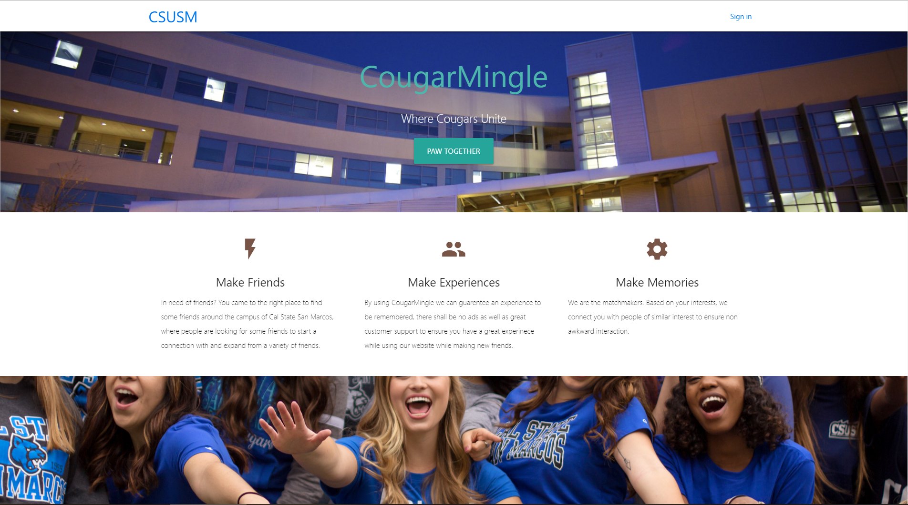
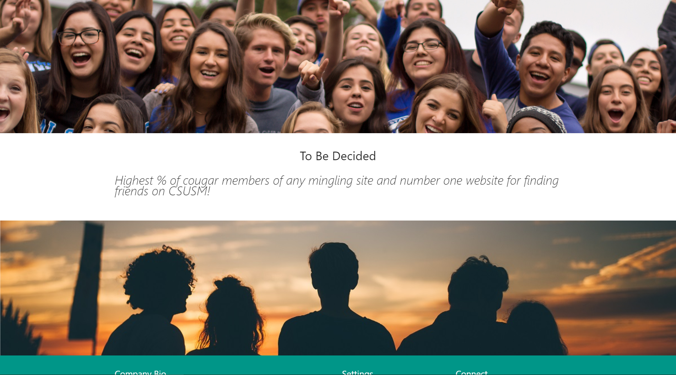
Michael
Able to make the homepage just the design is a little bit off.
Changed the whole homepage and was able to make progress.
Was able to finish editing the whole homepage

Slide 3
Zachary
Monday morning: Started personality questionnaire
Monday afternoon: added categories/pictures to questionnaire
Tuesday morning: Connected survey to the sign in page

Slide 4
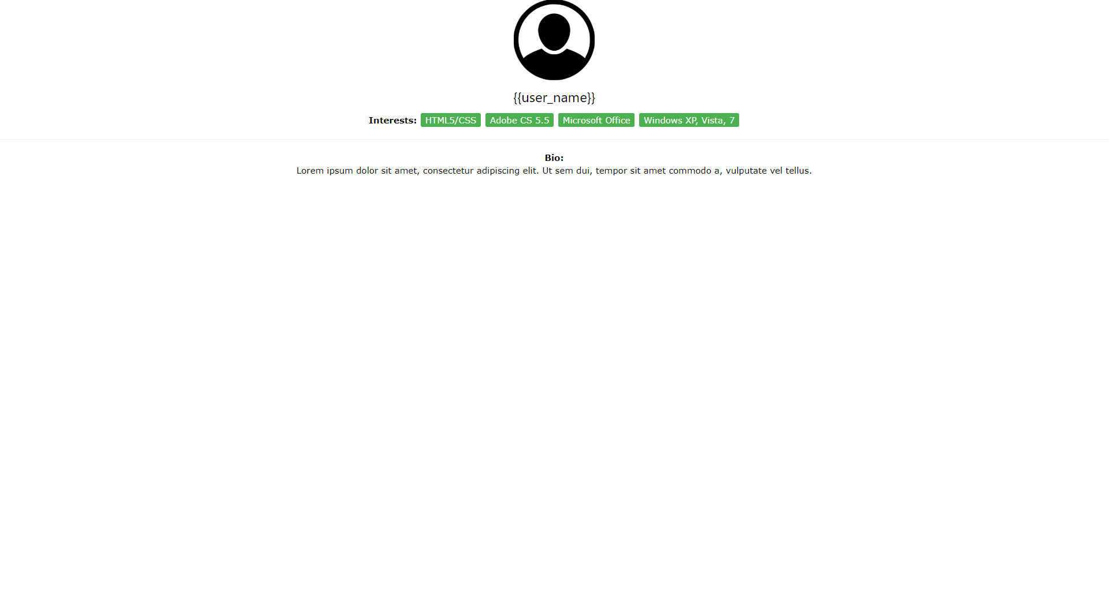
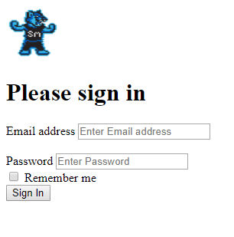
Gaby
Googles users API
Did sign up and sign in page
Did a user page

Slide 5
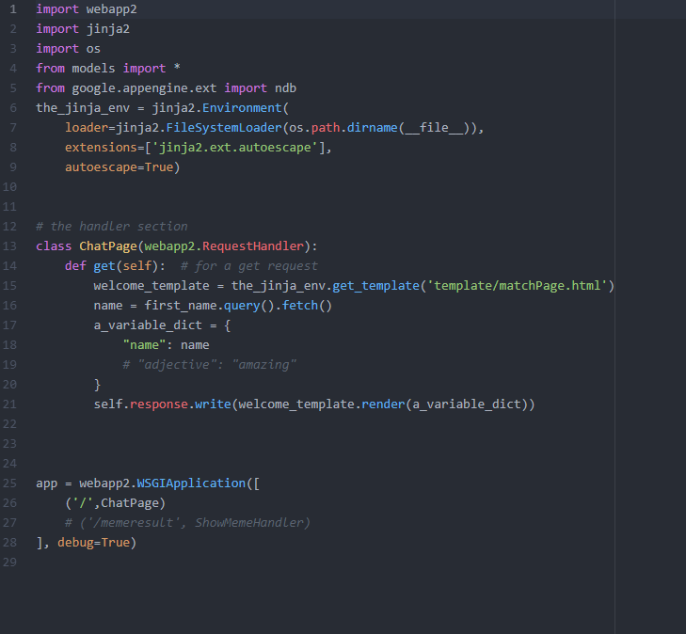
Jack
Formatted the site.
Started the chat site and played around with cloud database.
Some difficulties

